Slide 1

The cute & quiet virtual cat

Slide 2

User manual🇦🇺🇬🇧🇺🇸

Slide 3

















Presentation

Slide 4
A quiet virtual cat
2 mini games
7 food types
Friendly visits and presents
Single-button action, no sound, no death
Scoring system
Feed, cuddle, play, wash and educate
Runs on Arduino Nano
Available for Arduboy and M5 Stick C+

Slide 5
A quiet virtual pet
TiMiNoo ("Tee Me Noo") is a virtual cat providing minimal distraction, fully office-compatible, single button action, no sound, no death. The cat is different on each run, his characteristics are randomly picked at startup. It has been created with busy people in mind: The gameplay is simple enough to be enjoyed in a work environment.
TiMiNoo is a feature-rich virtual cat, a companion for busy days: Cuddle, Feed, Educate, Wash and Entertain your very own digital companion.

Slide 6
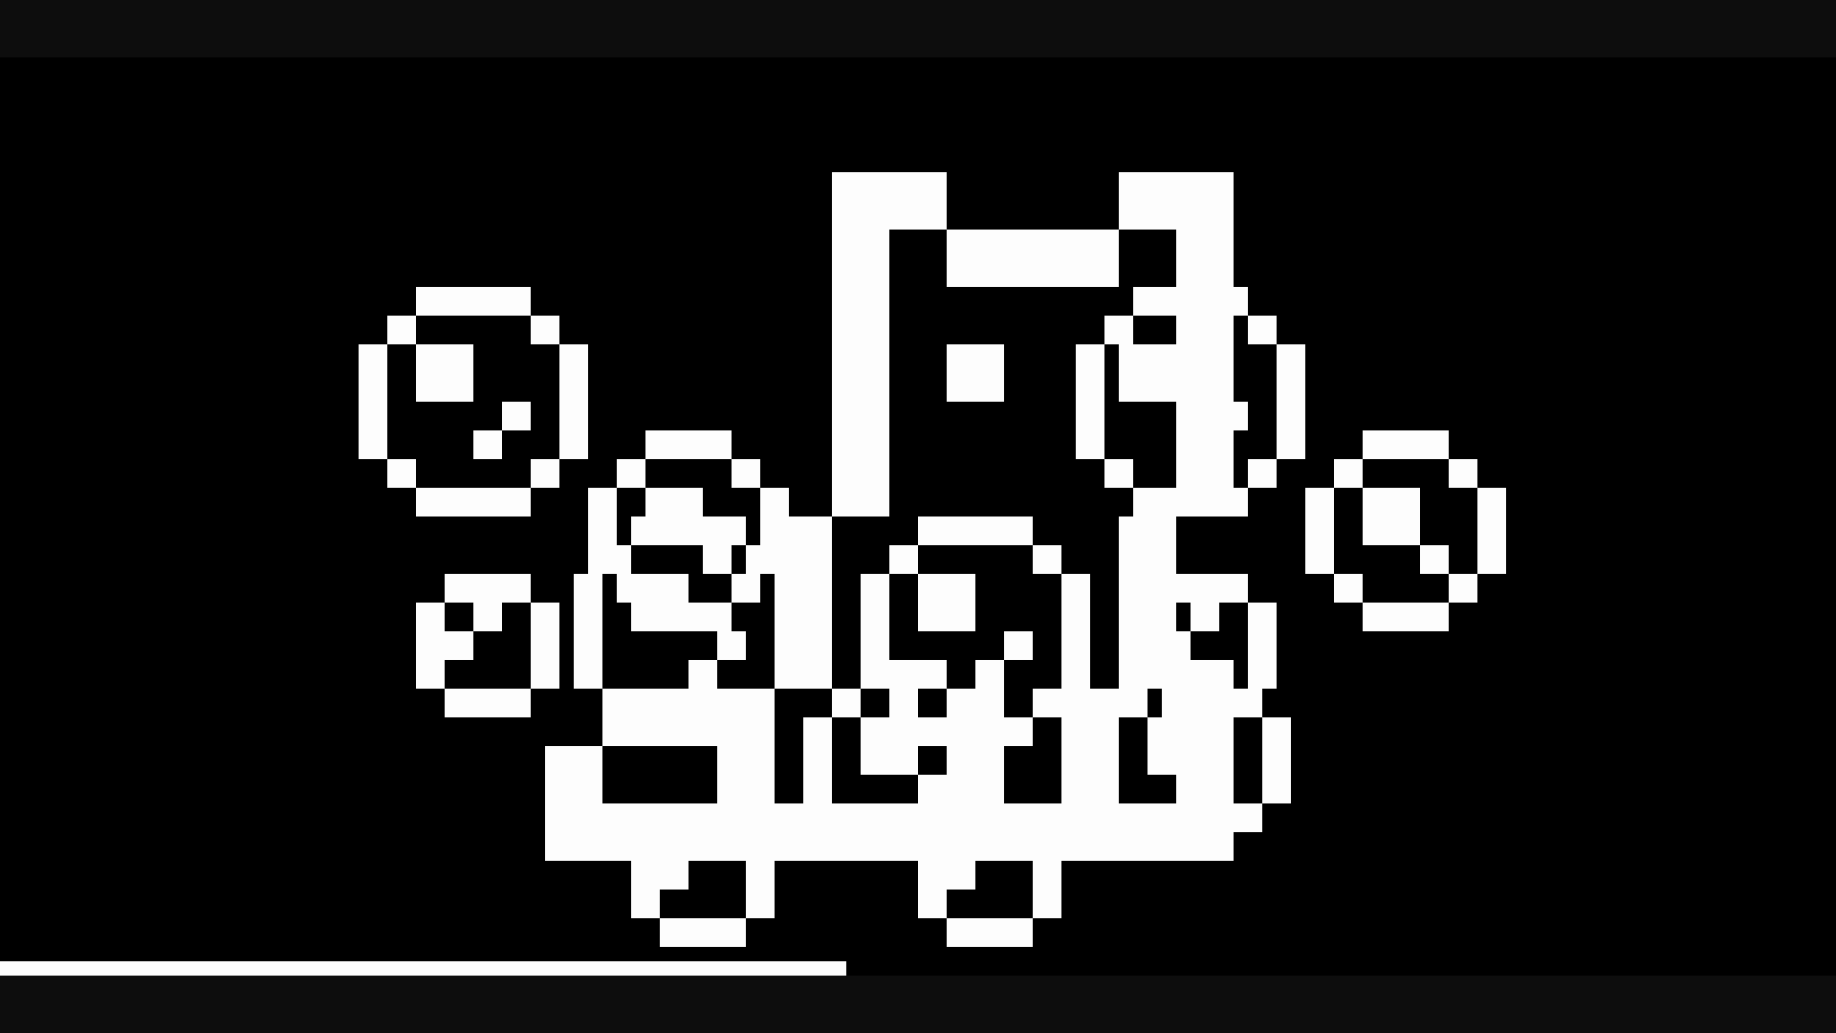



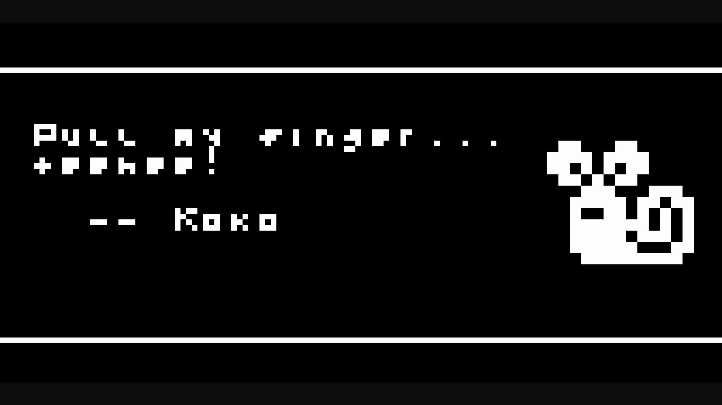
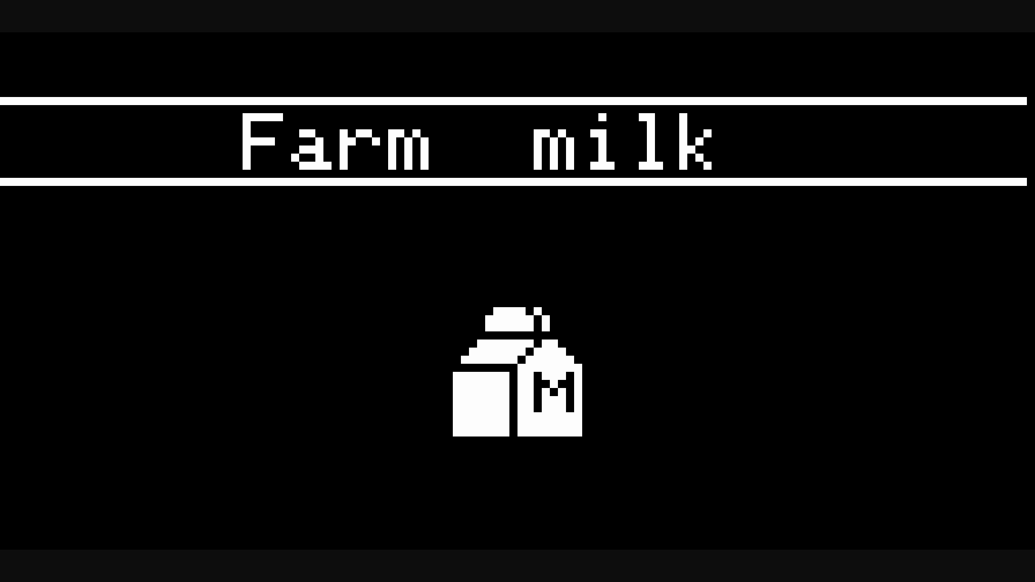

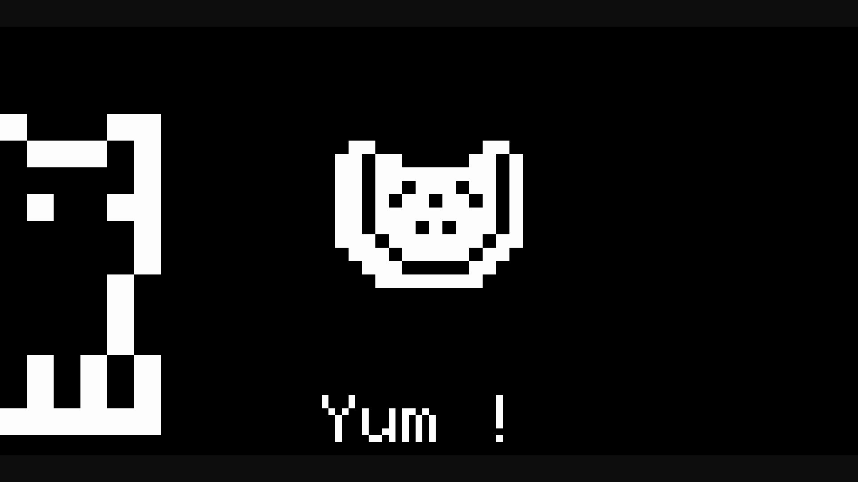



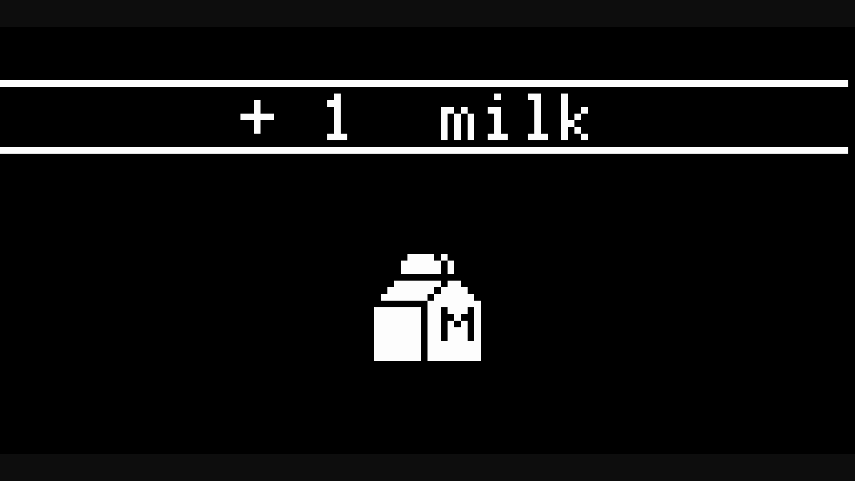


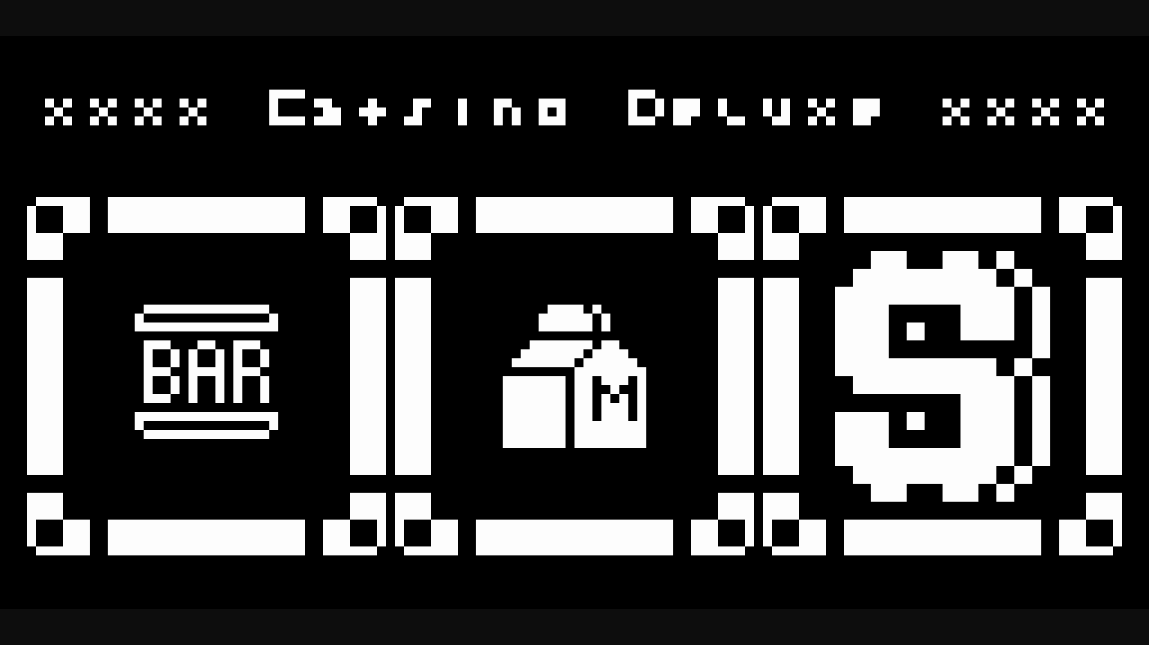
Features

Slide 7
Single button gameplay
A single button is all you need to enjoy TiMiNoo. Click once or click repeatedly depending on the action, that's it.

Slide 8
No sound
Having a virtual pet on your desk at work is lovely, but you certainly need to preserve your workflow from distractions. That’s why TiMiNoo produces no beeping sounds.

Slide 9
2 mini games
Catsino Deluxe: Go to the casino with your TiMiNoo and do your best to win some yummy food to bring home. Beware of the ghost though!
Catwash Station: When the fur of your TiMiNoo gets dirty, it's time for a proper toilet. Scrub scrub!

Slide 10
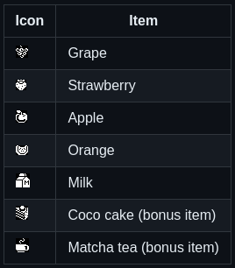
7 food items
Feed your TiMiNoo whenever he gets hungry. TiMiNoo doesn't die if you don't feed him, but he will give you that big eyes stare. Feed him a variety of food including:

Slide 11
Lessons with Professor Koko
TiMiNoo wants to become a cultured cat. Call Professor Koko Le Snail, a wise teacher that will share his best knowledge with him.

Slide 12
Cuddle time
TiMiNoo craves attention and love, make sure to give him plenty.

Slide 13
Visits from a friend
Occasionally, when TiMiNoo gets hungry, his friend comes home and offer either a cup of hot Matcha tea or a slice of home made Coco cake.

Slide 14
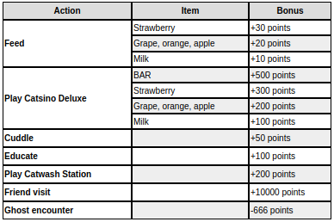
Gain points: scoring system

Slide 15
How to play

Slide 16
Starting the game
Plug your TiMiNoo to a 5V USB-C power supply to start a new game. There is no save feature and no experience, but scoring is available.

Slide 17
Starting the game
Every run is a fresh beginning with new statistics:
Appetite: How often your TiMiNoo will ask for food,
Hygiene: How quickly your TiMiNoo gets dirty,
Morale: How happy your TiMiNoo feels,
Education: How well trained your TiMiNoo is,
Entertainment: How often your TiMiNoo will want to play.

Slide 18
Starting the game
TiMiNoo never dies, even if you don’t take proper care of him. This is intentional as this game is made to be office-compatible.

Slide 19
Understand what TiMiNoo wants
TiMiNoo will show you what he needs by displaying icons in speech bubbles.

Slide 20
Home screen
TiMiNoo looks straight at you, waving his tail. He is happy, simply enjoying the moment.

Slide 21
Home screen
Super happy: TiMiNoo will express his joy right after you take action on his needs:

Slide 22
TiMiNoo wants to play
TiMiNoo looks at a gamepad icon:

Slide 23
TiMiNoo wants to learn
TiMiNoo looks at a book icon:

Slide 24
TiMiNoo is hungry
TiMiNoo looks at a pizza slice icon:

Slide 25
TiMiNoo wants to cuddle
TiMiNoo looks at a half-empty heart icon:

Slide 26
TiMiNoo needs a bath
TiMiNoo looks at a bubble icon:

Slide 27
Play the games, interact
In this section, we will see how to play Catsino Deluxe and Catwash Station, how to cuddle, educate and feed TiMiNoo. Every action raises your score!

Slide 28
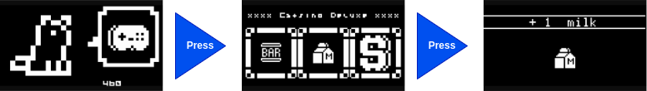
How to play Catsino Deluxe

Slide 29
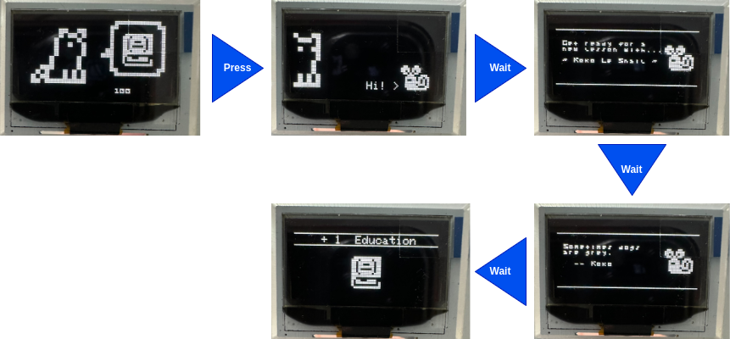
How to get a lesson with Koko

Slide 30
Koko’s words of wisdom
Sometimes dogs are grey
                – Koko Le Snail

Slide 31
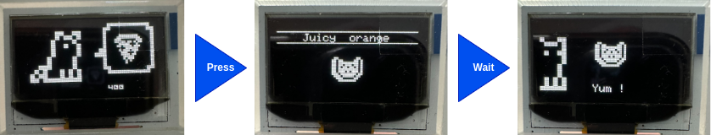
How to feed TiMiNoo

Slide 32
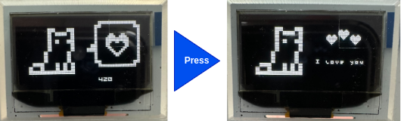
How to cuddle with TiMiNoo

Slide 33
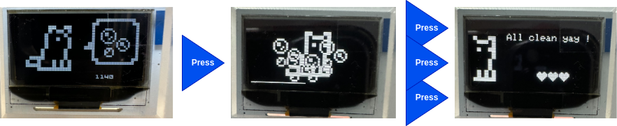
How to play Catwash Station

Slide 34
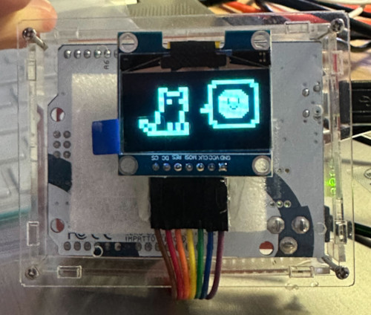
Build your own

Slide 35
Items
Here is what you need to build your TiMiNoo:
1x Arduino Leonardo R3,
1x Button,
1x 128*64 OLED screen,
1x 10k Ohm resistor,
1x breadboard or prototyping board,
1x Acrylic enclosure for UNO / Leonardo,
Enough jumper cables.

Slide 36
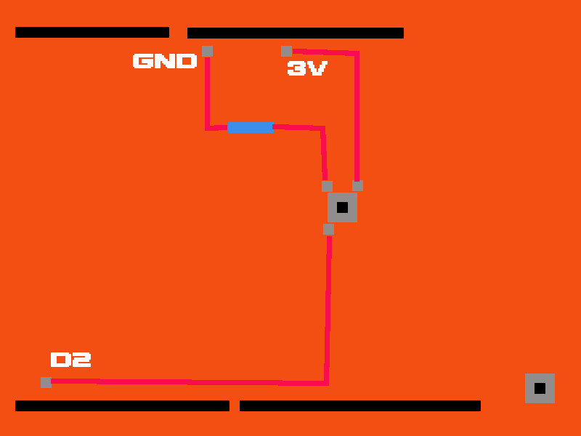
Assembly

Slide 37
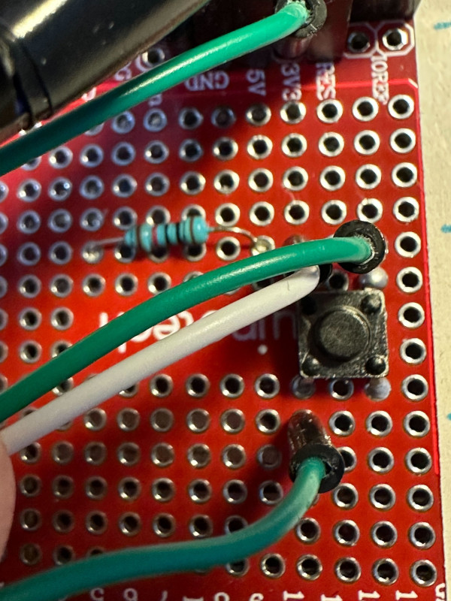
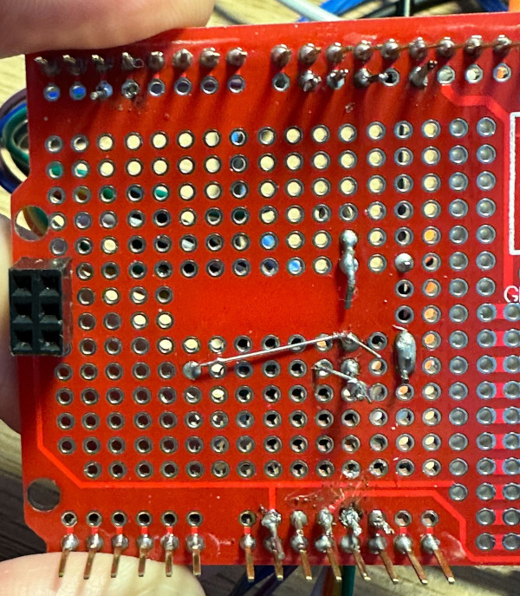
Assembly

Slide 38
Screen pinout
DC -> D9
CS -> D10
MOSI -> D11
CLOCK -> D13
RES -> RST
VCC -> 5V
GND -> GND

Slide 39
Button pinout
SIG -> D2
VCC -> 3V
GND -> GND

Slide 40
Installation instructions
Use Arduino IDE to upload timinoo.ino to your Arduino Leonardo. Make sure you use a Micro USB cable that supports data transfer, as some cables do not have data lines wired and only provide charging capability.

